Slide 1
RECRUITMENT
AND
SELECTION

Slide 2
HUMAN RESOURCE
MANAGEMENT
BUSINESS OBJECTIVES
HR PLANNING
JOB ANALYSIS
JOB DESCRIPTION
JOB SPECIFICATION
RECRUITMENT

Slide 3

RECRUITMENT
The Process of generating a pool of qualified candidates for a particular job.
OR
The Process of discovering potential candidates.

Slide 4
RECRUITMENT GOALS
1
Attract the Qualified Applicants.
2
Encourage Unqualified Applicants to self-select themselves out.

Slide 5

RECRUITMENT IS A TWO
WAY STREET
Organization is Looking for a Qualified Applicants
Applicants are Looking for the Potential Emplacement Opportunities
RECRUITMENT

Slide 6
RECRUITMENT PROCESS
ORGANIZATION
CANDIDATE
Vacant or New position occurs
Receive Education and choose Occupation
Generate candidate pool via internal or external recruitment methods
Acquire Employment Experience
Evaluate Candidates via Selection process
Search for Job Openings
Impress Candidates
Apply for jobs
Make Offer
Impress Company during Selection process
Evaluate Jobs and Companies
Accept or Reject Job Offers

Slide 7
STRATEGIC RECRUITING
DECISIONS
HR PLANNING DECISIONS
How Many Employees Needed
When Needed
KSAs Needed
Special Qualifications
Where to Recruit: Internal/External
Who to Recruit: Flexible Staffing
Options ( Contractual, Seasonal, full/part time etc.)
Nature of Job Requirements
STRATEGIC RECRUITING DECISIONS
DECISIONS ON RECRUITING
SOURCES/METHODS
Advertising Choices
Recruiting Activities

Slide 8


SOURCES OF RECRUITMENT
SOURCES OF
RECRUITMENT
INTERNAL
SOURCES
EXTERNAL
SOURCES

Slide 9
SOURCES OF RECRUITMENT
Job Posting &
Bidding
Promotions and
Transfers
INTERNAL
SOURCES
Re-recruiting former Employees & Applicants
Internal Recruiting
Data base

Slide 10
SOURCES OF RECRUITMENT Cont . . .
INTERNAL SOURCES
ADVANTAGES | DISADVANTAGES
Morale of Promotee Better assessment of abilities Lower cost for some jobs Motivator for good performance Causes a succession of promotions Have to hire only at entry level | Inbreeding Possible morale problems of those not promoted “Political” infighting for promotions Need for management- Development program

Slide 11
SOURCES OF RECRUITMENT Cont . . .
Schools Colleges &
Universities
EXTERNAL
SOURCES
Labor
Unions
Media Sources
Employment Agencies

Slide 12
SOURCES OF RECRUITMENT Cont . . .
Employee References
EXTERNAL
SOURCES
Factory gate hiring
Labour contractors
Casual callers

Slide 13
SOURCES OF RECRUITMENT Cont . . .
EXTERNAL SOURCES
ADVANTAGES | DISADVANTAGES
New “blood” brings new perspectives Cheaper and faster than training Professionals No group of political supporters in company May bring new industry insights | May not select someone who will “fit” the job or organization May cause morale problems for internal Candidates not selected Longer “adjustment” or orientation time

Slide 14






INTERNET RECRUITING METHODS
INTERNET RECRUITING
METHODS
1. Job Boards
2. Employer Web Sites

Slide 15
INTERNET RECRUITING
METHODS Cont . . .
ADVANTAGES | DISADVANTAGES
Cost savings Time savings Expanded pool of applicants | More unqualified applicants Additional work for HR staff members Many applicants are not seriously seeking employment Access limited or unavailable to some applicants

Slide 16
RECRUITING EVALUATION
Quantity of Applicants
Quality of
Applicants
As the goal of a good recruitment program is to generate a large pool of applicants from which to choose, quantity is a natural place to begin evaluation
In addition to quantity, the issue arises as to whether or not the qualifications of the applicant pool are sufficient to fill the job openings. Do the applicants meet job specification and do they perform the jobs well after hire?
Yield Ratio
Evaluating Recruiting Costs and Benefits
A comparison of the number of applicants at one stage of the recruiting process to the number at the next stage.
In a cost/benefit analysis to evaluate recruiting efforts, costs may include both direct costs (advertising, recruiters’ salaries, travel, agency fees, telephone) and the indirect costs (involvement of operating managers, public relations, image).

Slide 17
RECRUITING EVALUATION Cont . . .
Using Yield Ratios to Determine Needed Applicants:
300 Applicants
Initial Contacts/Final Interview
(Yield ratio = 3:1)
100 Final Interviews
Final Interview/Offers
(Yield ratio = 2:1)
50 Offers
Offers/Hires
(Yield ratio = 2:1)
25 Hires

Slide 18


CONSTRAINTS ON RECRUITMENT
Image of the Company
Attractiveness of Job
Internal Organizational Policy
Recruitment Cost

Slide 19
BUSINESS OBJECTIVES
HR PLANNING
JOB ANALYSIS
JOB DESCRIPTION
JOB SPECIFICATION
RECRUITMENT
SELECTION

Slide 20
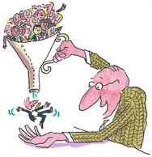

SELECTION
1
The Process of making a “Hire” or “No Hire” decision regarding each applicant for a job.
2
Selection is the process of choosing qualified individuals who are available to fill the positions in organization.
Or

Slide 21
BASIC SELECTION
CRITERIA
Formal Education
BASIC SELECTION
CRITERIA
Experience and Past Performance
Physical Characteristics
Personality Characteristics

Slide 22
SELECTION PROCESS
Initial screening
Fail to meet minimum qualification
Passed
Failed to complete job application or failed job specification
Completed application
Passed
Employment test
Failed Test
Passed
Passed
Conditional job offer
Comprehensive interview
Failed to impress interviewer and / meet job expectations
Background Examination if required
Problem encountered
Reject Applicant
Passed
Medical/physical examination if required (conditional job offer
Unfit to do essential elements of job
Able to perform essential elements of job
Permanent job offer

Slide 23
SELECTION METHODS
The Three most Common Methods used are:
1. Testing
2. Gathering Information
3. Interviewing

Slide 24

SELECTION METHODS Cont . . .
1. TESTING
Tests measure knowledge, skill, and ability, as well as other characteristics, such as personality traits.
TESTING TYPES
Cognitive Ability Test
Personality Test
Physical Ability Test
Integrity Test
Drug Test
Work Sample Testing

Slide 25
SELECTION METHODS Cont . . .
1. Cognitive Ability Testing
2. Physical Ability Testing
It measures the learning, understanding, and ability to solve problems. e.g. Intelligence Tests.
It assesses muscular strength, cardiovascular endurance, and coordination.
TESTING
TYPES
3. Personality Testing
It measures the patterns of thought, emotion, and behavior. e.g. Myers Briggs

Slide 26
SELECTION METHODS Cont . . .
4. Integrity Testing
6. Drug Testing
It is designed to assess the likelihood that applicants will be dishonest or engage in illegal activity.
Normally requires applicants to provide required sample that is tested for illegal substances.
TESTING
TYPES
5. Work Sample Testing
Measures performance on some element of the job.

Slide 27
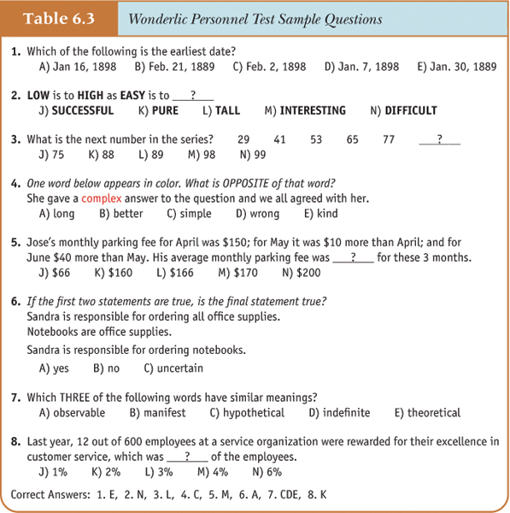
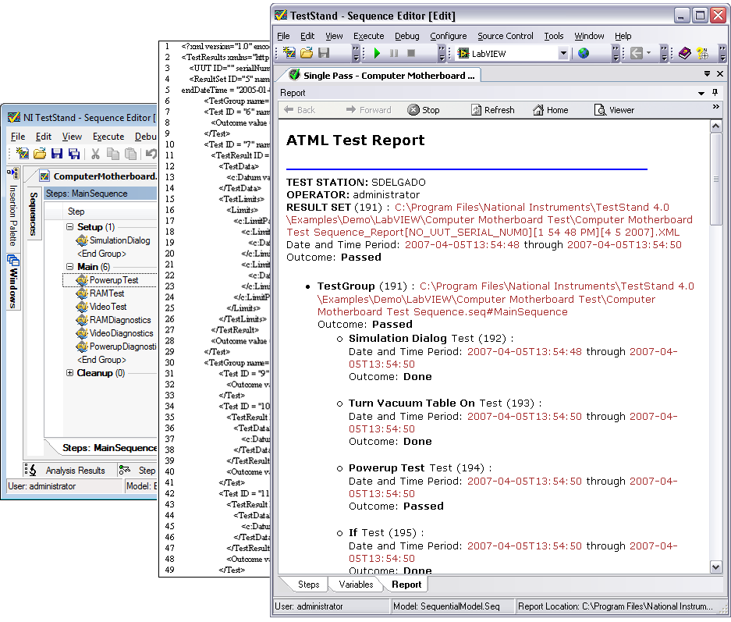
SELECTION METHODS Cont . . .
TEST
SAMPLE

Slide 28

SELECTION METHODS Cont . . .
2. INFORMATION GATHERING:
Common methods for gathering information include application forms and résumés, biographical data, and reference checking.

Slide 29
SELECTION METHODS Cont . . .
Generally ask for information such as address and phone number, education, work experience, and special training.
At the professional-level, similar information is generally presented in résumés.
Application Forms and Résumés
Biographical
Data
Historical events that have shaped a person’s behavior and identity.
Involves contacting an applicant’s previous employers, teachers, or friends to learn more about the applicant Issues with reference checking
Reference Checking

Slide 30
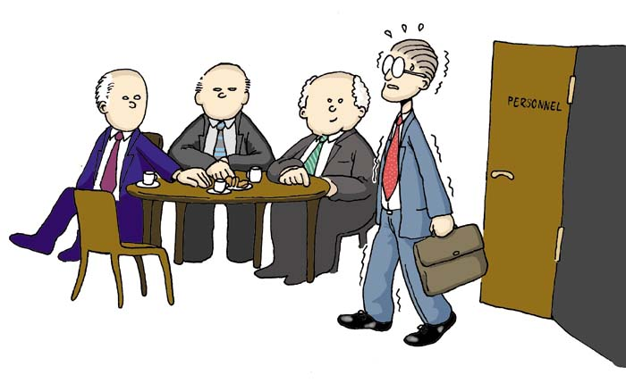
SELECTION METHODS Cont . . .
3. INTERVIEWS:
The interview is the most frequently used selection method.
Interviewing occurs when applicants respond to questions posed by a manager or some other organizational representative (interviewer).
Typical areas in which questions are posed include education, experience, knowledge of job procedures, mental ability, personality, communication ability, social skills.

Slide 31
SELECTION METHODS Cont . . .
Situational Interview
1. Structured Interviews
Behavioral Interview
Types of Interviews
2. Unstructured Interviews

Slide 32
SELECTION METHODS Cont . . .
1. Structured
Interviews
2. Unstructured
Interviews
Uses a list of predetermined questions. All applicants are asked the same set questions. There are two types of structured interviews.
Interviews-open ended questions are used such as “Tell me about yourself”
SITUATIONAL INTERVIEW
In which the interviewer asks questions about what the applicant would do in a hypothetical situation
BEHAVIORAL INTERVIEW
In which the questions focus on the applicant’s behavior in past situations.
This allows the interviewer to probe and pose different sets of questions to different applicants.

Slide 33
Attract the Qualified Applicants
Internal Recruitment Sources
Organizational Data Base
Job Posting
Promotions & Transfers
Recruitment
Goals
Employee Focused
Employee Referrals
Re-recruit Former
Employee
Encourage Unqualified Applicants to self select themselves out
External Recruitment Sources
Colleges & Universities
Professional Organizations
Employee Leasing
Organization is looking for a Qualified Applicants
Unsolicited Applications
Media Sources & Job Fairs
Placement Agencies
Recruitment
(2 way process)
RECRUITMENT
Applicants are also looking for the Opportunities
Internet Recruitment Sources
Job Boards
Employer Web Sites
Budgeting
Regular vs. Flexible
Recruiting Evaluation
Quantity of Applicants
Quality of Applicants
Yield Ratio
Strategic Recruitment Decisions
Image of the Company
Attractiveness of Job
Organizational vs. Outsourcing
Internal vs. External
Constraints on Recruiting
Recruitment
&
Selection
Internal Org. Policy
Recruitment Cost
Formal Education
Experience and Past Performance
Basic Selection Criteria
Cognitive Ability Test
Personality Test
Physical Ability Test
Physical Characteristics
KSA
Testing
Integrity Test
Drug Test
Work Sample Test
Personality Characteristics
Other Characteristics
Application Forms
Resumes
Biographical Data
Initial Screening
Completed Application
Employment Test
Comprehensive Interview
Conditional Job Offer
Background Examination
Medical or Physical Examination
Permanent Job Offer
Information Gathering
SELECTION
Reference Checking
Defamation of Character
Negligent Hiring
Selection process
Interviews
Structured
Situational
Behavioral
Unstructured
Common Interviewing Mistakes
Snap Judgments
Halo Effect
Horn Effect
Management Quality Circle
Negative
Emphasis
Cultural Noise
Biases
Testing
Gathering information
Selection Methods
Interviews

Slide 34
PLACEMENT & INDUCTION

Slide 35
PLACEMENT
Placement is the process of assigning a specific job to each one of the selected candidates.
It is the actual posting of an employee to a specific job.
It involves assigning a specific rank and responsibility to an individual.

Slide 36
BENEFITS OF PROPER PLACEMENT
The employees is able to :-
Show good results on the job.
Get along with people easily.
Keep his spirits high, report for duty regularly.
Avoid mistakes and accidents.
Thus, Placement is an important Human Resource activity.

Slide 37
INDUCTION/ORIENTATION
Induction or Orientation is:
“the process of receiving and welcoming an employee when he/she first joins a company and giving him/her the basic information s/he needs to settle down quickly & happily and start work.”
It is the process of indoctrination, welcoming and socialization.
Notes:
37

Slide 38
OBJECTIVES OF INDUCTION
An Orientation programme is designed to serve the following purposes :-
To explain duties & responsibilities, company policies & rules and other relevant information to the newcomer.
To help the person overcome his natural shyness & nervousness.
To make the new entrant feel at home & develop a sense of pride in the organization.

Slide 39
OBJECTIVES OF INDUCTION
To develop among the newcomers a sense of belonging & loyalty to the organization.
To foster a close & cordial relationship between the newcomer and the old employees, supervisor.
To give necessary information such as location of cafeteria, restrooms, leave rules etc.

Slide 40
INDUCTION PROGAMME:STEPS
1.Organizational Issues:
History of company
Organizational structure
Names & titles of key executives
Employee’s title & department
Company policies & rules
Disciplinary procedures
Safety measures

Slide 41
CONTD…
2. Employee benefits:
Pay scales, pay days
Leaves
Training & development avenues
Counselling procedures
Grievance handling procedure
Insurance, medical, recreation, retirement benefits.
3. Introductions:
- To supervisors - To trainers
- To co-workers - To employee counselor

Slide 42
CONTD…
4. Job duties:
Job location
Job tasks
Overview of jobs
Job objectives
Relationship with other jobs
SOCIALIZATION
FOLLOW UP

Slide 43

THOUGHT OF THE DAY
“If an HR person is trying to choose people for an organization, knowing their values is very important-if they are not consistent with the organization’s values they are not likely to stay very long.”
Professor, Roger Collins.

Slide 44
THANK YOU

